Slide 1
Topics Covered
Relational Design Theory
What is it for
Functional Dependencies
Closures
Finding Candidate Keys
Normalisation
Third Normal Form (3NF)
Boyce-Codd Normal Form (BCNF)
Decomposition
Minimal Cover and 3NF Decomposition
BCNF Decomposition

Slide 2
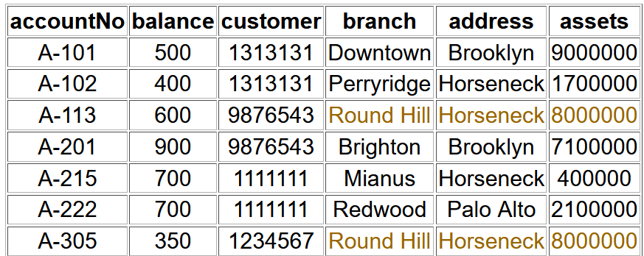
What is it For?
Mainly to find a database structure that has a balance between having redundant columns (repeated data across multiple tables), and ensuring that the structure withholds data integrity by preventing anomalies when updating the database.
We want to capture all the necessary attributes and relationships, with a minimal amount of stored information.
Redundancy is generally bad (problems with updating the database), but sometimes can be used to prevent the use of JOIN to collect bits of data.
Student(zID, Name, Surname, Address)
CourseEnrolments(zID, Name, Surname, Course, CourseName)
Storing zID, Name, Surname twice is redundant and can cause problems when updating these fields.
Just make zID in CourseEnrolments a foreign key referencing Student, and remove Name and Surname inside CourseEnrolments (as zID can determine them).
Above table combines Accounts and Branches into one table which reduces redundancy of repeating branch info in a separate Branch table (a branch foreign key would create redundancy), but causes other potential problems.
Insertion anomaly:
When we insert a new record, we need to check that branch data is consistent with existing tuples.
Update anomaly:
If a branch changes address, we need to update all Account tuples referring to that branch as well.
Deletion anomaly:
If we remove information about the last account at a branch, all of the branch information disappears, despite only wanting to delete account information.

Slide 3
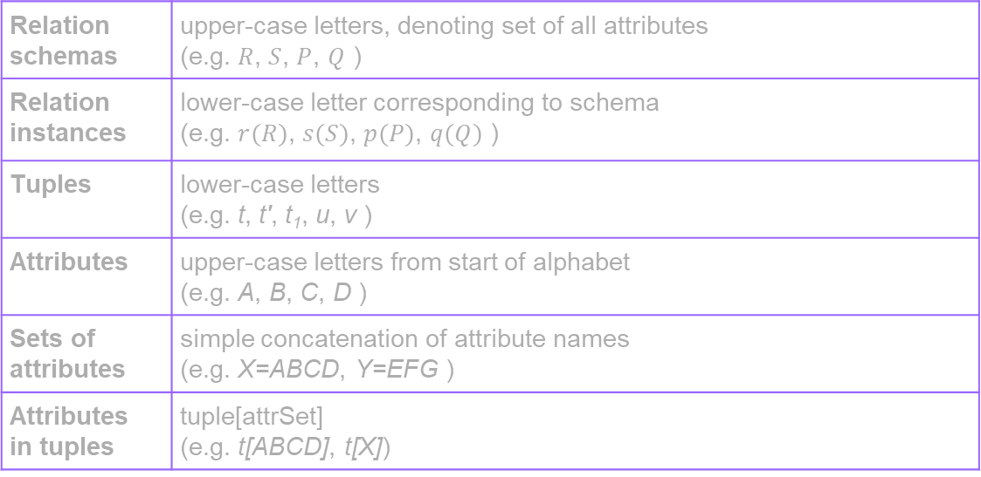
Notation/Terminology
Relation schemas | upper-case letters, denoting set of all attributes (e.g. $R$, $S$, $P$, $Q$ )
Relation instances | lower-case letter corresponding to schema (e.g. $r(R)$, $s(S)$, $p(P)$, $q(Q)$ )
Tuples | lower-case letters (e.g. t, t', t₁, u, v )
Attributes | upper-case letters from start of alphabet (e.g. A, B, C, D )
Sets of attributes | simple concatenation of attribute names (e.g. X=ABCD, Y=EFG )
Attributes in tuples | tuple[attrSet] (e.g. t[ABCD], t[X])

Slide 4
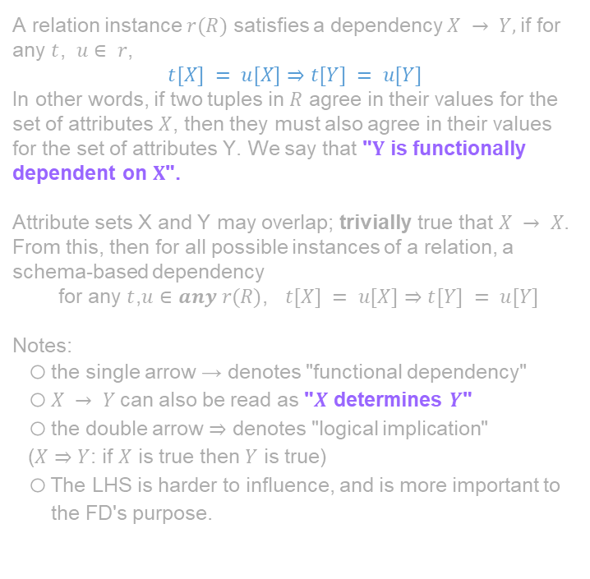
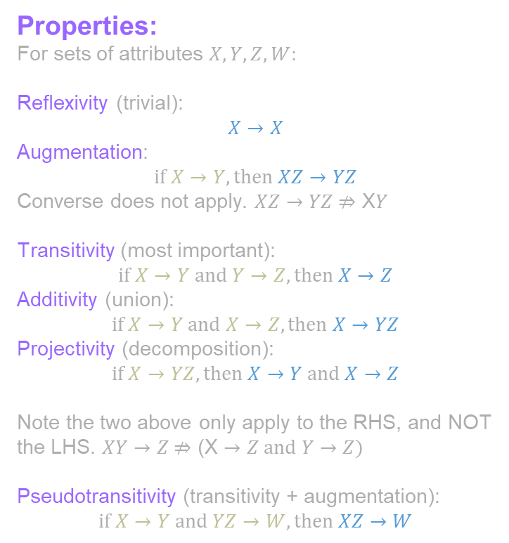
Functional Dependency
Properties:
For sets of attributes $X,Y,Z,W:$
Reflexivity (trivial):
$$X→X$$
Augmentation:
$$if X→Y, then XZ→YZ$$
Converse does not apply. $XZ→YZ \text{⇏} \text{X}Y$
Transitivity (most important):
$$if X→Y and Y→Z, then X→Z$$
Additivity (union):
$$if X→Y and X→Z, then X→YZ$$
Projectivity (decomposition):
$$if X→YZ, then X→Y and X→Z$$
Note the two above only apply to the RHS, and NOT the LHS. $XY→Z \text{⇏}\text{ (}\text{X}→Z and Y→Z)$
Pseudotransitivity (transitivity + augmentation):
$$if X→Y and YZ→W, then XZ→W$$
A relation instance $r(R)$ satisfies a dependency $X → Y,$if for any $t$, $u∈ r$,
$$t[X] = u[X]⇒t[Y] = u[Y]$$
In other words, if two tuples in $R$ agree in their values for the set of attributes $X$, then they must also agree in their values for the set of attributes Y. We say that "$Y$ is functionally dependent on $X$".
Attribute sets X and Y may overlap; trivially true that $X → X$.
From this, then for all possible instances of a relation, a schema-based dependency
for any $t$,$u∈any r(R)$, $t[X] = u[X]⇒t[Y] = u[Y]$
Notes:
the single arrow → denotes "functional dependency"
$X → Y$can also be read as "$X$ determines $Y$"
the double arrow ⇒ denotes "logical implication"
($X⇒Y$: if $X$ is true then $Y$ is true)
The LHS is harder to influence, and is more important to the FD's purpose.

Slide 5
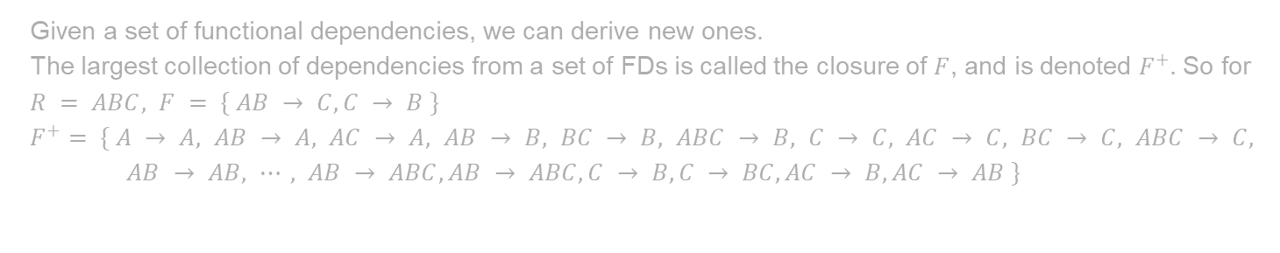
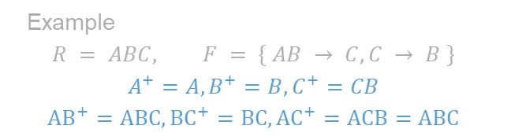
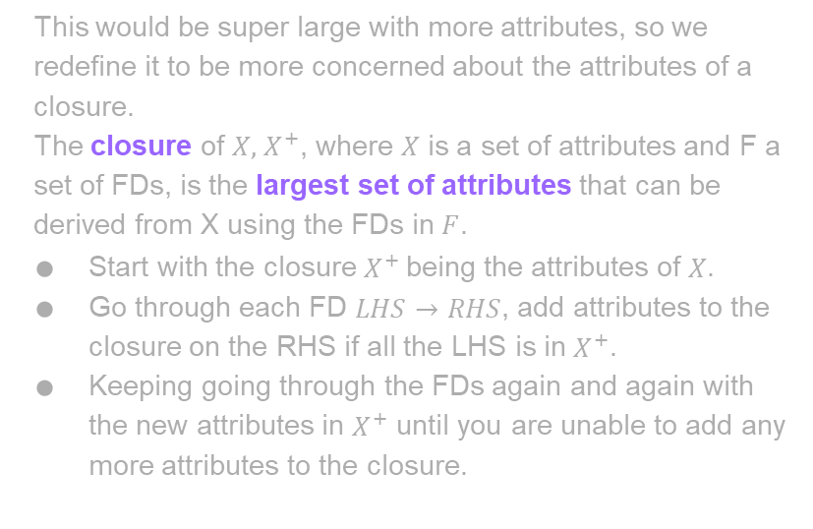
Closures
Given a set of functional dependencies, we can derive new ones.
The largest collection of dependencies from a set of FDs is called the closure of $F$, and is denoted $F^{+}.$ So for $R = ABC, F = \{ AB → C,C → B \}$
$F^{+}$ $= \{ A → A, AB → A, AC → A, AB → B, BC → B, ABC → B, C → C, AC → C, BC → C, ABC → C, AB → AB, ⋯, AB → ABC, AB → ABC, C → B, C → BC, AC → B, AC → AB \}$
This would be super large with more attributes, so we redefine it to be more concerned about the attributes of a closure.
The closure of $X, { X}^{+}$, where $X$ is a set of attributes and F a set of FDs, is the largest set of attributes that can be derived from X using the FDs in $F$.
Start with the closure $X^{+}$being the attributes of $X$.
Go through each FD $LHS→RHS$, add attributes to the closure on the RHS if all the LHS is in $X^{+}$.
Keeping going through the FDs again and again with the new attributes in $X^{+}$ until you are unable to add any more attributes to the closure.
Input: F (set of FDs), X (starting attributes)
Output: X+ (attribute closure)
Closure = X
while (not done) {
OldClosure = Closure
for each A->B such that A
add B to Closure
if (Closure == OldClosure) done = true
}
Example
$$R = ABC, F = \{ AB → C,C → B \}$$
$$A^{+}=A, B^{+}=B, C^{+}=CB$$
$${AB}^{+}=ABC,{BC}^{+}=BC, {AC}^{+}=ACB=ABC$$

Slide 6
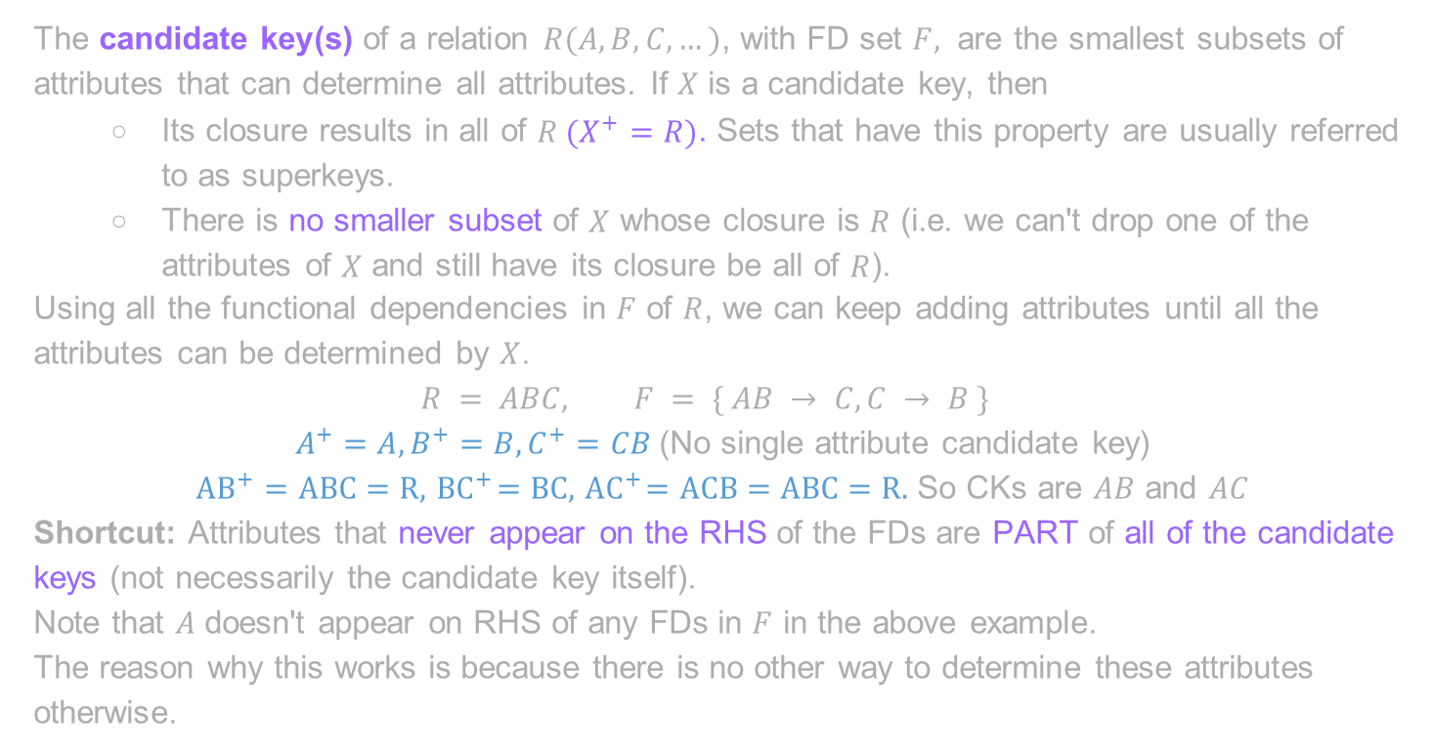
Finding Candidate Keys
The candidate key(s) of a relation $R(A,B,C,…)$, with FD set $F,$ are the smallest subsets of attributes that can determine all attributes. If $X$ is a candidate key, then
Its closure results in all of $R (X^{+}=R)$. Sets that have this property are usually referred to as superkeys.
There is no smaller subset of $X$ whose closure is $R$ (i.e. we can't drop one of the attributes of $X$ and still have its closure be all of $R$).
Using all the functional dependencies in $F$ of $R$, we can keep adding attributes until all the attributes can be determined by $X$.
$$R = ABC, F = \{ AB → C,C → B \}$$
$A^{+}=A, B^{+}=B, C^{+}=CB$ (No single attribute candidate key)
${AB}^{+}=ABC=R, { BC}^{+}=BC, { AC}^{+}=ACB=ABC=R.$ So CKs are $AB$ and $AC$
Shortcut: Attributes that never appear on the RHS of the FDs are PART of all of the candidate keys (not necessarily the candidate key itself).
Note that $A$ doesn't appear on RHS of any FDs in $F$ in the above example.
The reason why this works is because there is no other way to determine these attributes otherwise.

Slide 7
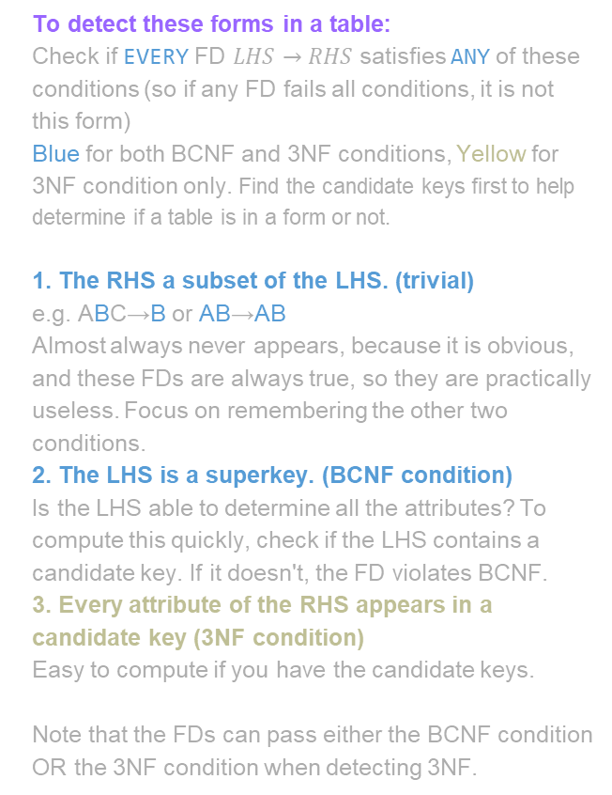
Normal Forms
To detect these forms in a table:
Check if EVERY FD $LHS→RHS$ satisfies ANY of these conditions (so if any FD fails all conditions, it is not this form)
Blue for both BCNF and 3NF conditions, Yellow for 3NF condition only. Find the candidate keys first to help determine if a table is in a form or not.
1. The RHS a subset of the LHS. (trivial)
e.g. ABC→B or AB→AB
Almost always never appears, because it is obvious, and these FDs are always true, so they are practically useless. Focus on remembering the other two conditions.
2. The LHS is a superkey. (BCNF condition)
Is the LHS able to determine all the attributes? To compute this quickly, check if the LHS contains a candidate key. If it doesn't, the FD violates BCNF.
3. Every attribute of the RHS appears in a candidate key (3NF condition)
Easy to compute if you have the candidate keys.
Note that the FDs can pass either the BCNF condition OR the 3NF condition when detecting 3NF.
Normalisation is the process of designing a database schema to prevent data anomalies, whilst also not creating too much redundancy.
Normal forms describe how 'normalised' the database is.
The forms range from 1NF to 6NF, with BCNF being 3.5NF. The more normalised, the more data integrity errors we prevent, but the data tends to become more spread out and create some redundant columns.
Forms we care about in this course (industry-acceptable):
Boyce-Codd Normal Form (BCNF)
eliminates all redundancy due to functional dependencies
but may not preserve original functional dependencies
Third Normal Form (3NF)
eliminates most (but not all) redundancy due to FDs
guaranteed to preserve all functional dependencies
If the database is BCNF, then it is automatically 3NF as well, as BCNF is stricter; 3NF has an extra condition that makes tables slightly more likely to be 3NF if not BCNF.
If all tables are 3NF, the schema is in 3NF. Same logic for BCNF.
If a table is not 3NF/BCNF, we can decompose that table into multiple smaller tables that are all 3NF/BCNF.
Note that schemas made from ER-diagrams tend to be BCNF.

Slide 8
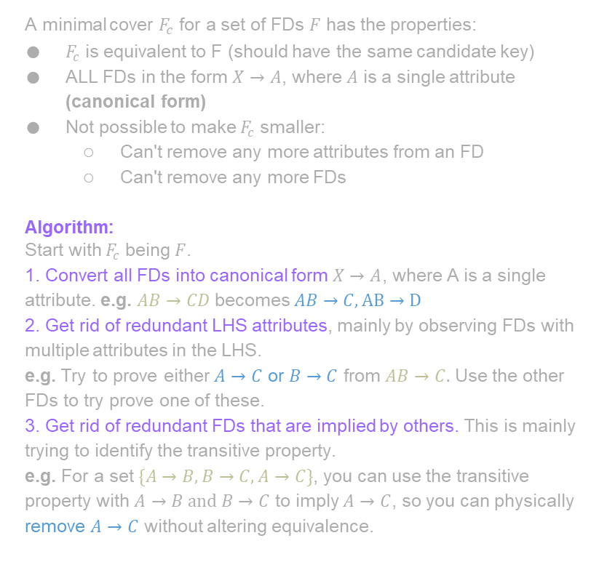
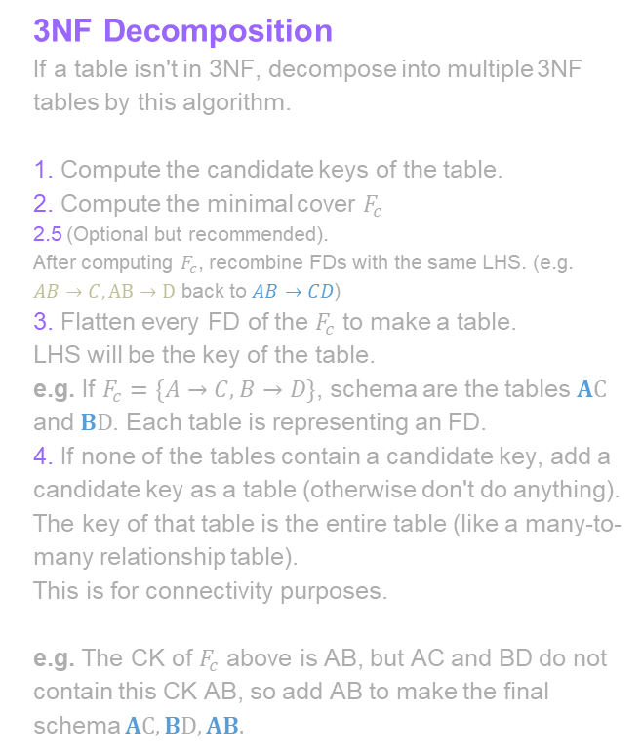
Minimal Cover and 3NF Decomposition
A minimal cover $F_{c}$ for a set of FDs $F$ has the properties:
$F_{c}$ is equivalent to F (should have the same candidate key)
ALL FDs in the form $X→A$, where $A$ is a single attribute (canonical form)
Not possible to make $F_{c}$ smaller:
Can't remove any more attributes from an FD
Can't remove any more FDs
Algorithm:
Start with $F_{c}$ being $F$.
1. Convert all FDs into canonical form $X→A$, where A is a single attribute. e.g. $AB→CD$ becomes $AB→C, AB→D$
2. Get rid of redundant LHS attributes, mainly by observing FDs with multiple attributes in the LHS.
e.g. Try to prove either $A→C$ or $B→C$ from $AB→C.$ Use the other FDs to try prove one of these.
3. Get rid of redundant FDs that are implied by others. This is mainly trying to identify the transitive property.
e.g. For a set $\{A→B,B→C, A→C\}$, you can use the transitive property with $A→B and B→C$ to imply $A→C$, so you can physically remove $A→C$ without altering equivalence.
3NF Decomposition
If a table isn't in 3NF, decompose into multiple 3NF tables by this algorithm.
1. Compute the candidate keys of the table.
2. Compute the minimal cover $F_{c}$
2.5 (Optional but recommended).
After computing $F_{c}$, recombine FDs with the same LHS. (e.g. $AB→C, AB→D$ back to $AB→CD$)
3. Flatten every FD of the $F_{c}$ to make a table. LHS will be the key of the table.
e.g. If $F_{c}=\{A→C, B→D\}$, schema are the tables $AC$ and $BD$. Each table is representing an FD.
4. If none of the tables contain a candidate key, add a candidate key as a table (otherwise don't do anything). The key of that table is the entire table (like a many-to-many relationship table).
This is for connectivity purposes.
e.g. The CK of $F_{c}$ above is AB, but AC and BD do not contain this CK AB, so add AB to make the final schema $AC, BD, AB.$

Slide 9

Minimal Cover and 3NF Decomposition
A minimal cover $F_{c}$ for a set of FDs $F$ has the properties:
$F_{c}$ is equivalent to F (should have the same candidate key)
ALL FDs in the form $X→A$, where $A$ is a single attribute (canonical form)
Not possible to make $F_{c}$ smaller:
Can't remove any more attributes from an FD
Can't remove any more FDs
Algorithm:
Start with $F_{c}$ being $F$.
1. Convert all FDs into canonical form $X→A$, where A is a single attribute. e.g. $AB→CD$ becomes $AB→C, AB→D$
2. Get rid of redundant LHS attributes, mainly by observing FDs with multiple attributes in the LHS.
e.g. Try to prove either $A→C$ or $B→C$ from $AB→C.$ Use the other FDs to try prove one of these.
3. Get rid of redundant FDs that are implied by others. This is mainly trying to identify the transitive property.
e.g. For a set $\{A→B,B→C, A→C\}$, you can use the transitive property with $A→B and B→C$ to imply $A→C$, so you can physically remove $A→C$ without altering equivalence.
3NF Decomposition
If a table isn't in 3NF, decompose into multiple 3NF tables by this algorithm.
1. Compute the candidate keys of the table.
2. Compute the minimal cover $F_{c}$
2.5 (Optional but recommended).
After computing $F_{c}$, recombine FDs with the same LHS. (e.g. $AB→C, AB→D$ back to $AB→CD$)
3. Flatten every FD of the $F_{c}$ to make a table. LHS will be the key of the table.
e.g. If $F_{c}=\{A→C, B→D\}$, schema are the tables $AC$ and $BD$. Each table is representing an FD.
4. If none of the tables contain a candidate key, add a candidate key as a table (otherwise don't do anything). The key of that table is the entire table (like a many-to-many relationship table).
This is for connectivity purposes.
e.g. The CK of $F_{c}$ above is AB, but AC and BD do not contain this CK AB, so add AB to make the final schema $AC, BD, AB.$

Slide 10
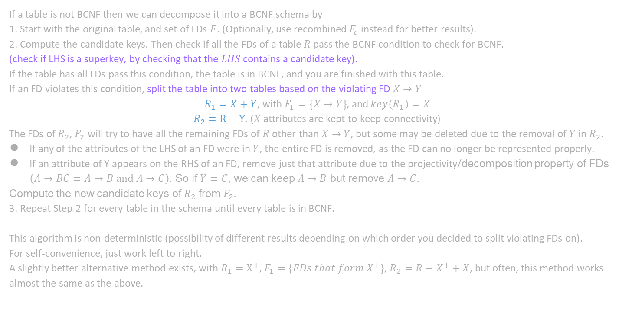
BCNF Decomposition
If a table is not BCNF then we can decompose it into a BCNF schema by
1. Start with the original table$,$and set of FDs $F$. (Optionally, use recombined $F_{c}$ instead for better results).
2. Compute the candidate keys. Then check if all the FDs of a table $R$pass the BCNF condition to check for BCNF.
(check if LHS is a superkey, by checking that the $LHS$ contains a candidate key).
If the table has all FDs pass this condition, the table is in BCNF, and you are finished with this table.
If an FD violates this condition, split the table into two tables based on the violating FD $X→Y$
$R_{1}=X+Y$, with $F_{1}=\{X→Y\}$, and $key\left(R_{1}\right)=X$
$R_{2}=R−Y.$ ($X$ attributes are kept to keep connectivity)
The FDs of $R_{2}$, $F_{2}$ will try to have all the remaining FDs of $R$ other than $X→Y$, but some may be deleted due to the removal of $Y$ in $R_{2}$.
If any of the attributes of the LHS of an FD were in $Y$, the entire FD is removed, as the FD can no longer be represented properly.
If an attribute of Y appears on the RHS of an FD, remove just that attribute due to the projectivity/decomposition property of FDs $\left(A→BC=A→B and A→C\right)$. So if $Y=C$, we can keep $A→B$ but remove $A→C$.
Compute the new candidate keys of $R_{2}$ from $F_{2}.$
3. Repeat Step 2 for every table in the schema until every table is in BCNF.
This algorithm is non-deterministic (possibility of different results depending on which order you decided to split violating FDs on).
For self-convenience, just work left to right.
A slightly better alternative method exists, with $R_{1}=X^{+},$ $F_{1}=\{FDs that form X^{+}\}$, $R_{2}=R−X^{+}+X$, but often, this method works almost the same as the above.

